Slide 1
Cars4U Project
Using linear regression model to predict prices of used cars

Slide 2
Background & Problem Statement

Slide 3
There is a rising trend of demand for used cars in the Indian Market.
In 2018-19, while new car sales were recorded at 3.6 million units, around 4 million second-hand cars were bought and sold.

Slide 4
We require a pricing model that can predict the price of used cars.
Hence, machine learning will be used for prediction.

Slide 5
An accurate model prediction can help in devising profitable strategies.
For example, if the business knows the market price, it will never sell anything below it.

Slide 6
In this case, linear regression model can be used to predict price of used cars.
As it fulfills the assumptions of zero mean of residual, homoscedasticity, and normality of residuals.

Slide 7
Data Dictionary

Slide 8
Variable | Description
S.No. | Serial Number
Name | Name of the car which includes brand name and model name
Location | Location in which car is being sold/available for purchase
Year | Manufacturing year of car
Kilometers_driven | Total kilometers driven in the car by previous owner(s)
Fuel_Type | Type of fuel used by car (Petro, Diesel, Electric, CNG, LPG)
Transmission | Type of transmission used by car (Automatic, Manual)
Owner | Type of ownership
Mileage | Standard mileage offered by the car company in kmpl or km/kg
Engine | Displacement volume of the engine in cc
Power | Maximum power of engine in bhp
Seats | Number of seats in the car
New_Price | The price of a new car of the same model
Price | The price of the used car in Lakhs

Slide 9
Manipulations to Data
Removal of New_Price column due to massive amounts of missing data
Removal of missing data, as they are of a small amount
Removal of serial number and car name data as they are irrelevant to linear regression modelling
Outlier removal for Kilometers_Driven, Mileage, Seats, Price as there are data points that are very extreme or that does not make sense (e.g. Seats = 0)
Reclassification of location into West, South, North and East
Creation of dummy variables to string/categorical variables
Removal of data with fuel type = Electric as there is only 2 data point and they have missing mileage data

Slide 10
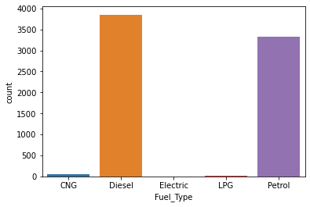
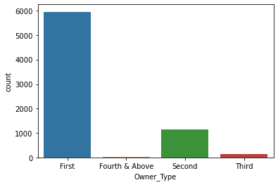
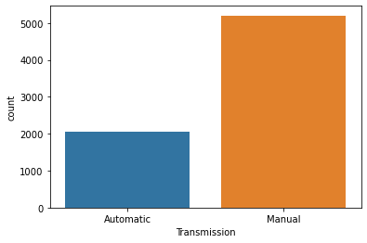
Exploratory Data Analysis Highlights
There are more cars with manual transmission
Most of the cars have the fuel type diesel and petrol
Most cars have been used by only one user

Slide 11
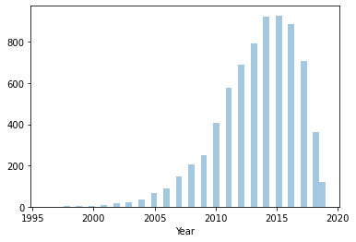
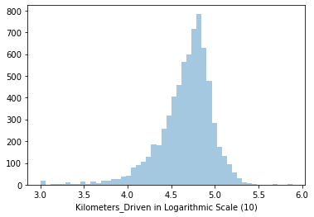
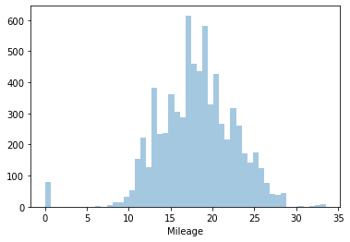
Exploratory Data Analysis Highlights
Most of the used cars are from around 2015
Mileage and Kilometers_Driven are normally distributed

Slide 12
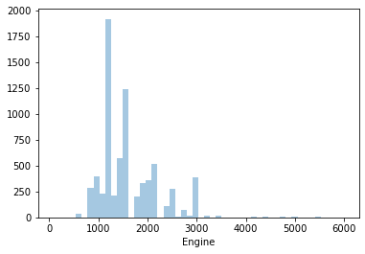
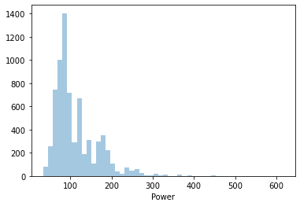
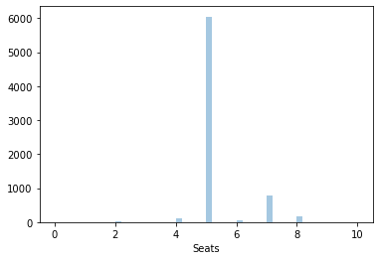
Exploratory Data Analysis Highlights
Engine and Power are right skewed – it’s more common for people to have (cheaper) cars with lower values of engine displacement and power
Most cars have 5 seats

Slide 13
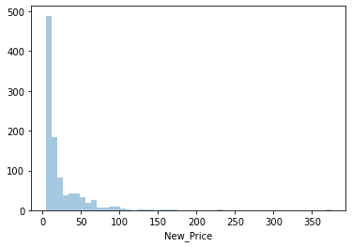
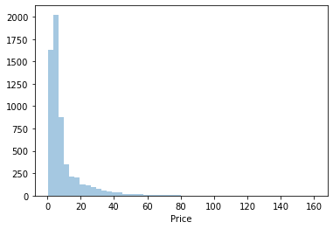
Exploratory Data Analysis Highlights
Both New_Price and Price are right skewed

Slide 14
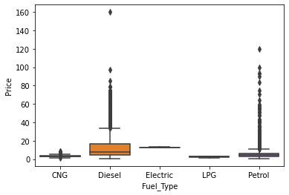
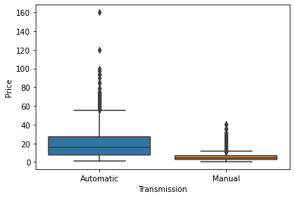
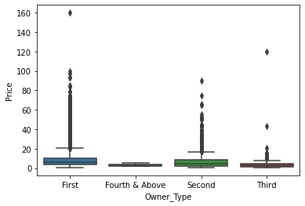
Exploratory Data Analysis Highlights
Cars with automatic transmission are more expensive than manual
Diesel cars are more expensive than other fuel types

Slide 15
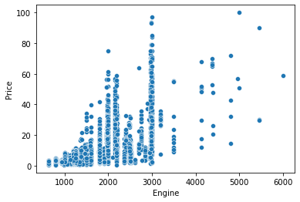
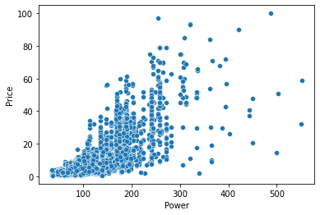
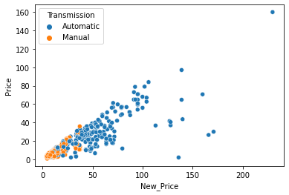
Exploratory Data Analysis Highlights
There are three specs that highly correlated to price :
Engine
Power
New_Price

Slide 16
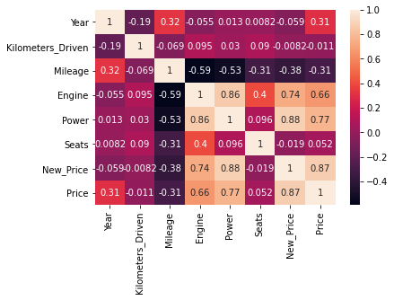
Exploratory Data Analysis Heatmap

Slide 17
Model Performance Summary
Linear regression model is applied to the data, with 70% of data used as training data and 30% of data used as testing data
The score of the model for training data is 71.6%
The score of the model for testing data is 72.6%
The main predictor of the used car price is Year, followed by Power

Slide 18
Variable | Intercept Value | Comments
Year | 0.8334528121289415 | Main predictor, large value in data (in e03)
Kilometers_Driven | -2.783077248099561e-05 | Small intercept value due to large value in data
Mileage | -0.16608964542208232
Engine | 0.0006515124756801809
Power | 0.12622836890494474 | 2nd main predictor
Seats | -0.7736896238039597
North (Location Dummy) | 1.3134837962696697 | Value of 0 for all location dummy means that the data is for East location
South (Location Dummy) | 2.3306083714443457
West (Location Dummy) | 0.7314467115731618
Diesel (Fuel Type Dummy) | -0.5564107586241958 | Value of 0 for all fuel type dummy means that the data is for CNG fuel type
LPG (Fuel Type Dummy) | 1.3647741576504258
Petrol (Fuel Type Dummy) | -3.482113186060177
Manual (Transmission Dummy) | -2.4132109425668 | 1 : Manual, 0 : Automatic
Fourth and Above (Owner Dummy) | 4.56925611149674 | Value of 0 for all owner dummy means that the data is for first owner only
Second (Owner Dummy) | -0.26005359373181275
Third (Owner Dummy) | 0.20112985212766243
Model Intercept | -1673.1186747550555

Slide 19
Recommendations to Business
Creation of used car shops in South India area, as there are more customers selling cars on that area
Focus marketing on/sell cars that are aged around 2015 as the price of cars will drop significantly after a year
To maximize profit, it will be great to have more stocks on used cars that have automatic transmission, high power and engine displacement, and few mileage as well as few kilometers driven. This can be derived from the linear regression model applied earlier.
Most customers have cars with manual transmission, 5 seats, fuel type of diesel/petrol, and lower power and engine displacement, hence it will be great to prepare inventory stock for these type of cars.

Slide 20
Model Improvement
Usage of polynomial features to the regression model
Model can be applied to data with missing values on price, so that we can make predictions on price value

